Slide 1
Lung Nodule Detection using Deep Convolutional Neural Networks
Submitted by: Lavleen Bhat
17210637
Supervisor: Alan Smeaton

Slide 2
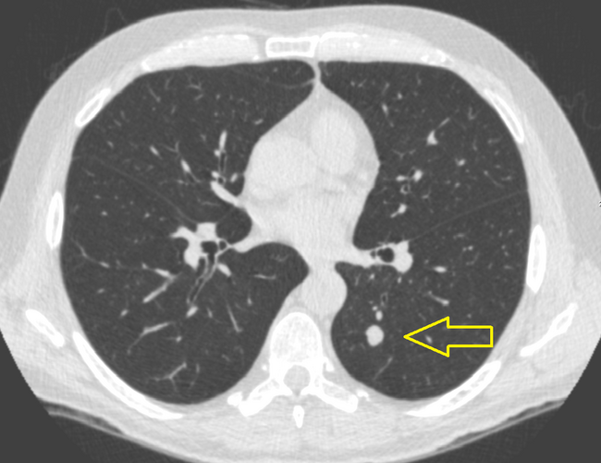
Business Understanding
Identify all the suspicious nodules inside lungs CT scans.
Source: Google Image

Slide 3
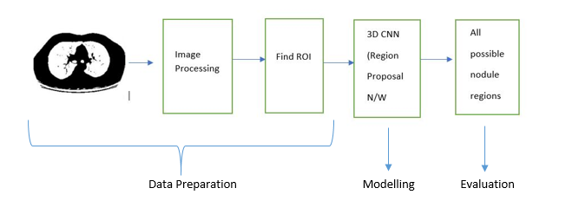
Project Pipeline

Slide 4
Data Understanding
Data contains 888 Low-dose 3D CT scans (250 slices each)
Divided into 70:30 training(623) and testing(265) data
CSV file with annotations of nodules with the diameter and coordinates
Obtained from LIDC/IDRI database
Open source cancer imaging archive
Each 3D image is in RAW (.MHD) format
Images size ranges between 60 MB to 500 MB
Total compressed data size is about 62 GB

Slide 5
Data Preparation
HDF5 Database
Files storage
Image pre-processing
Cleaning and de-noising the image
Marking Region-of-Interest
Preparing ground truth for training the network

Slide 6
1. Data Preparation – HDF5 Database
HDF5 enable storage of large numerical values
Read all the RAW images as NUMPY and stored in HDF5
Total size is about 62 GB in compressed format
Don’t need to unzip the data

Slide 7
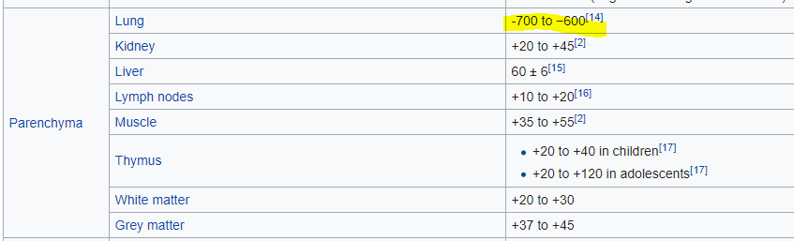
2. Data Preparation – Image pre-processing
Image resizing
Spacing (0.625 mm – 2.5 mm)
Number of slices (250)
Image Segmentation
Binary Conversion (Thresholding)
Noise Removal (Median Blur)
Morphological Operations (OPENING & CLOSING)
Clear Border and label image
Segmentation
Data Augmentation
Source: Hounsfield Unit Wikipedia

Slide 8
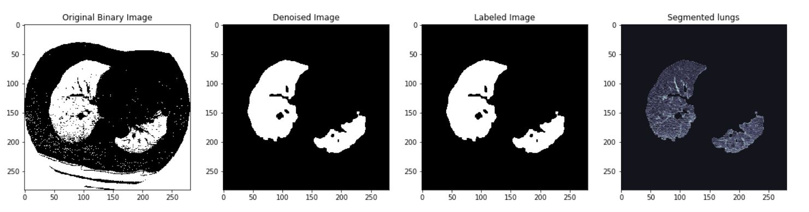
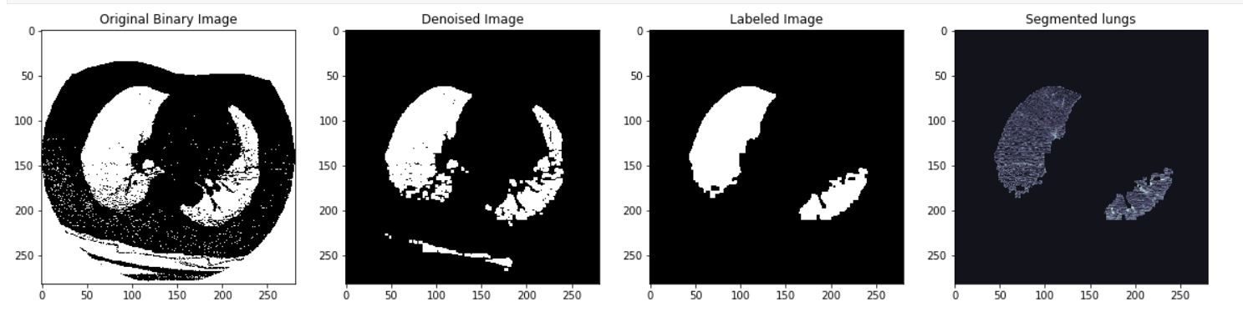
2. Image pre-processing Results

Slide 9
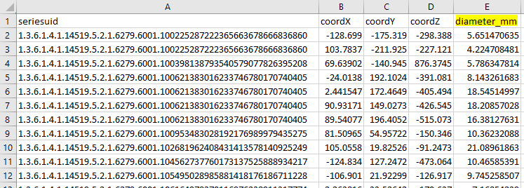
3. Data preparation – Marking RoI
Marked region of interest based on annotations
Annotations include nodule diameters

Slide 10
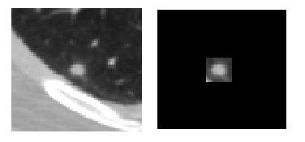
3. Marking ROI Results

Slide 11
Modelling
Trained on NVIDIA GTX 660 Ti GPU at Insight centre
Availed by my supervisor Alan
U-Net based 3D convolutional neural network architecture
Two models with 23 and 19 layers
Inspired from Faster RCNN region proposal network (RPN)
Inputs are – Segmented lungs (X) and nodule masks (Y) marked as RoI

Slide 12
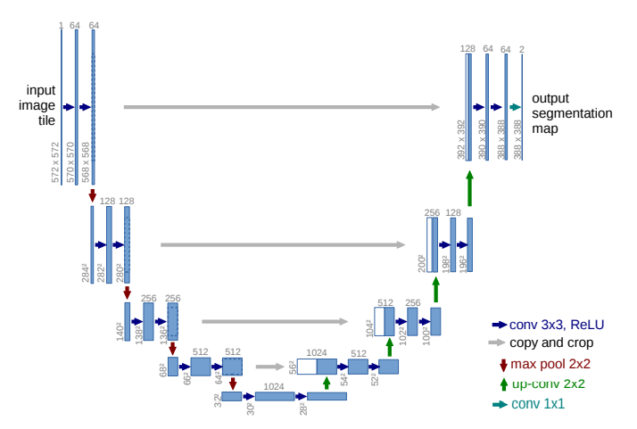
Model 2
Source: U-Net Paper

Slide 13
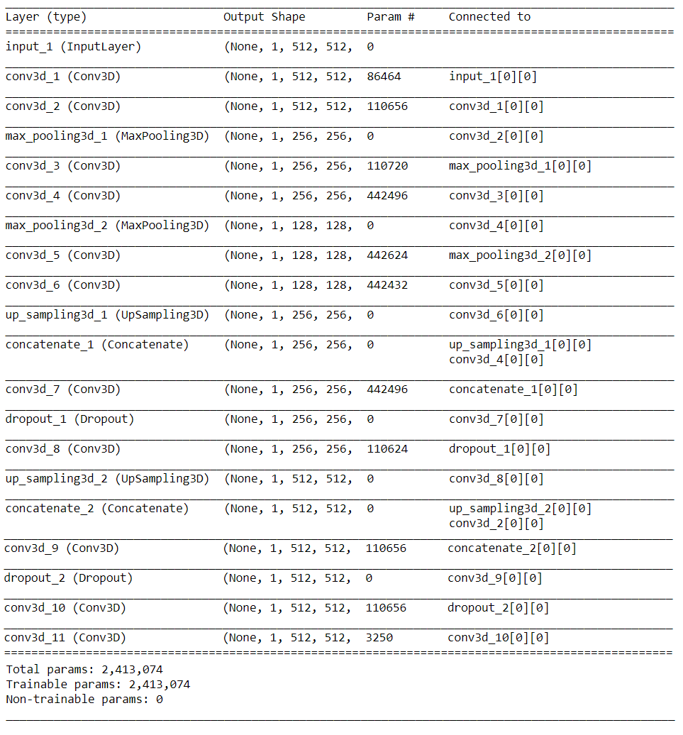

Slide 14
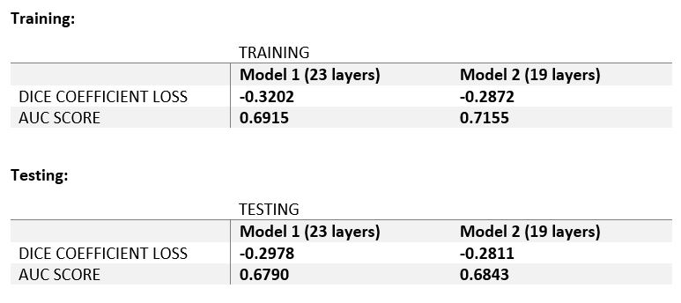
Evaluation
Dice Coefficient Loss Function
Area Under the Curve Score

Slide 15
Results and Findings
U-Net adaptation for 3D CNN works better than 2D implementation of same on medical imaging
Very deep convolutional networks are not always the answer
Getting better results with less deeper neural network

Slide 16
Conclusion and Future work
Segmented the lungs and extracted the suspicious lung nodules with and accuracy of about 70%
Future work includes the classification of these identified lung nodules

Slide 17
Credits for Code
Sequence generator from Stack Overflow
World to Voxel and Voxel to World coordinates conversion
From LUNA-16 tutorial
Dice coefficient loss function from Kaggle competition tutorial
https://www.kaggle.com/c/data-science-bowl-2017#tutorial
http://stackoverflow.com/questions/312443/how-do-you-split-a-list-into-evenly-sized-chunks

Slide 18
Thank you!

